Slide 1
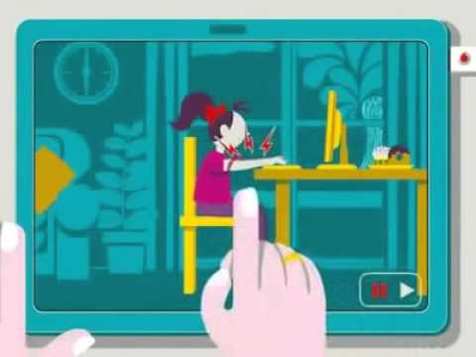
Health and Safety whilst using computers.

Slide 2
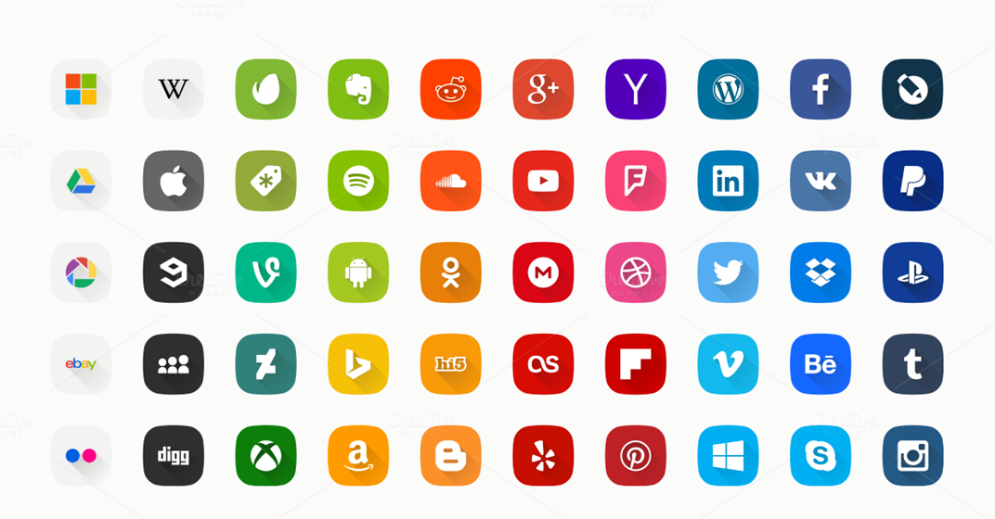
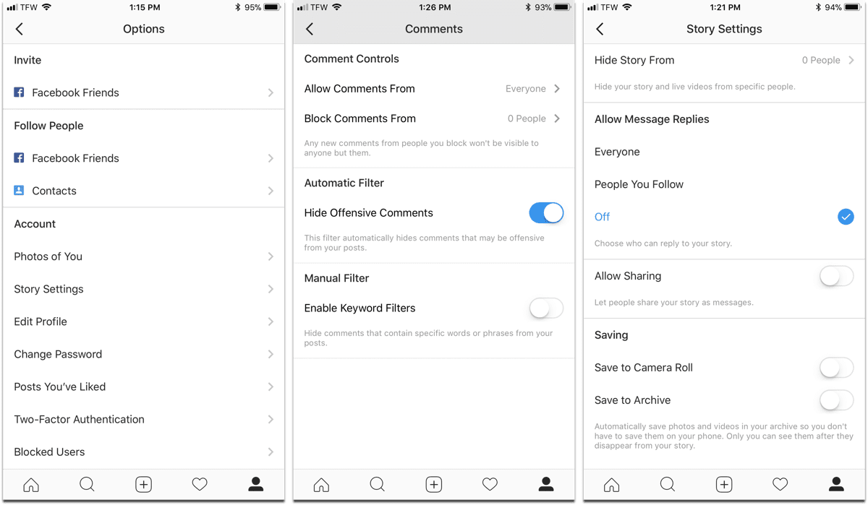
How you can stay safe on social media
One way you can stay safe on these websites is by setting your account to private like this:

